Slide 1
Integrating Deep Learning for Safety Management in Construction: Semantic Image-Rule Matching for Unsafe Behavior Detection Using YOLO-ESCA.
MEMBERS:
Abishek S (9517202109005)
Mohamed Aslam K (9517202109034)
GUIDE: Dr. P.Swathika , PhD, (AP(Sr.G))
Department of Artificial Intelligence and Data Science
Mepco Schlenk Engineering College

Slide 2
ABSTRACT
Detecting unsafe behaviors on construction sites.
Matching semantic safety rules with image analysis.
Combining ResNet-101 and Bidirectional GRU for feature extraction.
Achieving high accuracy through stacked cross-attention mechanisms.

Slide 3
AIM
To develop a construction site anomaly detection system.
To find all the anomaly behavior (Crowding over pit, working on top of the building with out safety gadgets etc..)

Slide 4
OBJECTIVE
To enhance detection accuracy by integrating cross-attention between image features and safety rule embeddings.
To utilize Faster R-CNN for extracting image features for safety monitoring.
To integrate a GRU network for embedding safety rules effectively.

Slide 5
LITERATURE SURVEY
Fatal accident patterns of building construction activities in China (2019)
Merits:
The study identifies accident patterns and correlations that are actionable for policymaking.
Provides targeted suggestions for improving workplace safety.
Demerits:
Only fatal accidents are analyzed, excluding non-fatal but severe incidents.
Issues like underreporting or misclassification might impact data reliability.

Slide 6
LITERATURE SURVEY
Recognizing people’s identity in construction sites with computer vision: A spatial and temporal attention pooling network (2020)
Merits:
Potential for real-time monitoring and feedback to improve workplace safety.
Effective feature extraction and matching across varied video conditions.
Demerits:
Relatively small dataset, focused on limited activities (e.g., walking), restricting generalizability.
High processing requirements for extracting attentive representations may cause delays.

Slide 7
LITERATURE SURVEY
Computer vision and long short-term memory: Learning to predict unsafe behaviour in construction (2021)
Merits:
High Accuracy: The SiamMask model achieves higher tracking accuracy than other methods like ASLA and SCM, with mAP scores exceeding 90% in some metrics.
Real-time Applicability: Predictive models allow for immediate action, enhancing safety measures on construction sites.
Demerits:
Static Hazard Zones: Hazardous areas were manually labeled and static, limiting adaptability to dynamic site changes.
Limited Scenarios: The model's generalizability is constrained as it was tested on specific use cases, like people approaching foundation pits

Slide 8
LITERATURE SURVEY
Imbalanced data classification: Using transfer learning and active sampling (2023)
Merits:
Improved Accuracy for Imbalanced Data: Active sampling and data augmentation ensure balanced learning for minority classes.
Efficient Model Design: Optimized memory and computational trade-offs for deep networks.
Demerits:
Limited Dataset Applicability: Performance might vary on datasets with extreme imbalance or entirely new domains.
Computational Overhead: Increased time due to active sampling and real-time augmentation.

Slide 9
LITERATURE SURVEY
A Bayesian-based knowledge tracing model for improving safety training outcomes in construction (2023)
Merits:
The model adapts training content dynamically based on individual learning progress and characteristics.
The BKT model identifies weak knowledge areas, leading to targeted training that significantly improves knowledge retention.
Demerits:
The framework has been tested in a controlled environment with undergraduate students, lacking real-world construction site validation.
Advanced models like Deep Knowledge Tracing require extensive data, which might not be feasible for small-scale applications.

Slide 10
LITERATURE SURVEY
YOLO-PL: Helmet wearing detection algorithm based on improved YOLOv4 (2024)
Merits:
Outperforms YOLOv4 and YOLOv7 in AP50 and recall, making it ideal for helmet detection tasks.
Reduces parameters and computational load, enhancing deploy ability in real-world scenarios.
Demerits:
AP75 is slightly lower compared to YOLOv7, indicating room for improvement in localization precision.
Slower than YOLOv7 tiny models, which might limit deployment in highly resource-constrained environment.

Slide 11
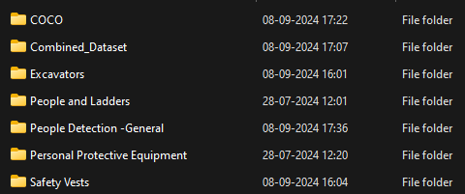
DATASET
Custom dataset which is pipelined from various sources combined to form single dataset with 193,000.
It consists of combination of all data

Slide 12
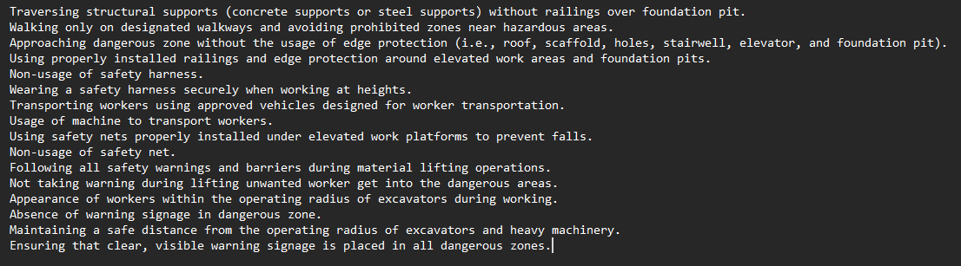
DATASET
Text Dataset are safety rules from Quality and Safety Check Points of Urban Rail Transit Engineering with both safe and unsafe behavior rules.
Safe Behavior
Unsafe Behavior

Slide 13
SAFETY RULE STANDARD
The safety rules standards followed in this paper are derived from Chinese safety standards and operating instructions, including:
1. Standard for Construction Safety Assessment of Metro Engineering (GB 50715-2011):
This standard focuses on safety requirements for metro construction projects, including hazardous area management and worker safety protocols.

Slide 14
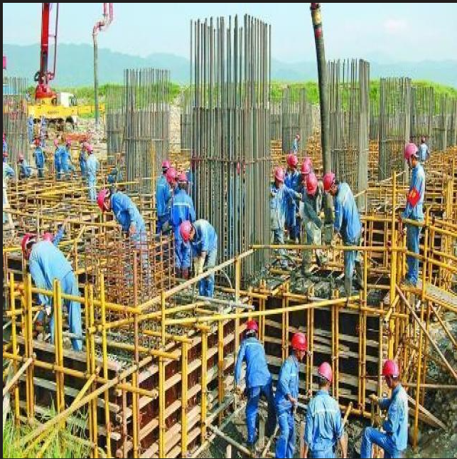
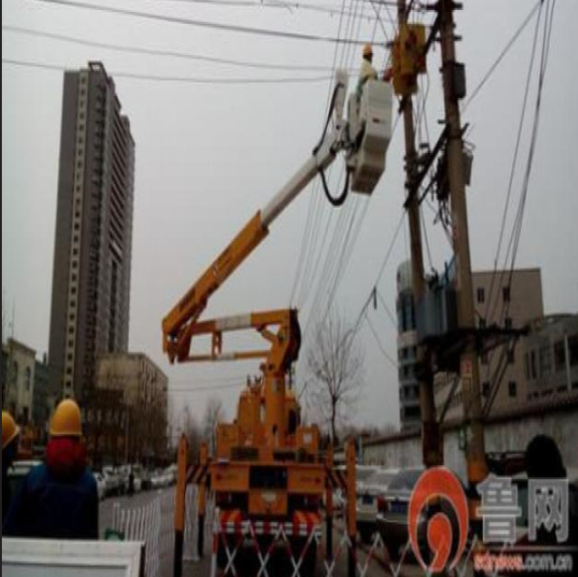
DATASET (SAMPLE)

Slide 15
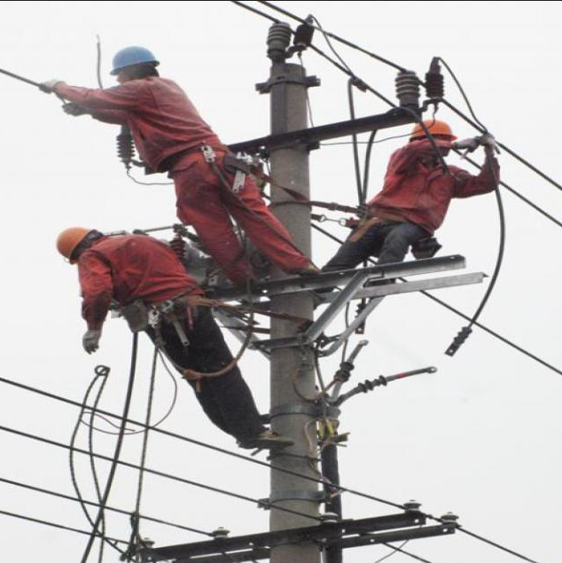
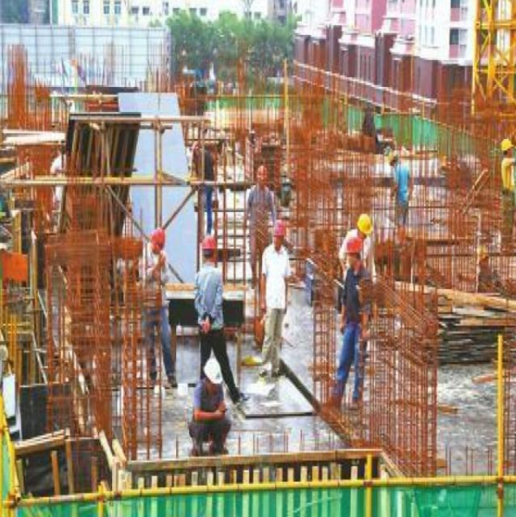
DATASET (SAMPLE)

Slide 16
PRE-PROCESSING
Combination of image datasets and classes
Dataset from multiple sources must be combined.
All the labels from each dataset must be mapped according to data combination.

Slide 17
PRE-PROCESSING ( CONTD…)
Splitting of test train images
The MS-COCO dataset does not include test images.
We need to extract the test data from the training images along with their labels, create a new folder for the test data, and then remove those images from the training set.

Slide 18
PRE-PROCESSING ( CONTD…)
Image Preprocessing: Resizing, Tensor Conversion, and Normalization
Image Resizing: Adjusts images to a fixed size to ensure compatibility with the model's input dimensions.
Image-to-Tensor Conversion: Converts image data into a tensor format, scaling pixel values and reordering channels as required by the model.
Normalization: Standardizes pixel values (typically between 0 and 1 or using a dataset-specific mean and standard deviation) to improve training stability and convergence.

Slide 19
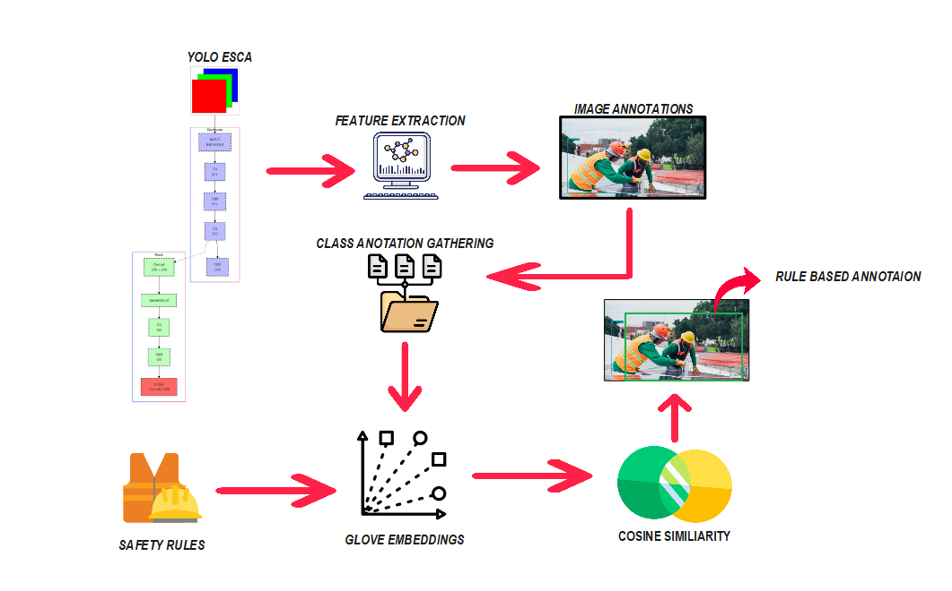
Overall Architecture

Slide 20
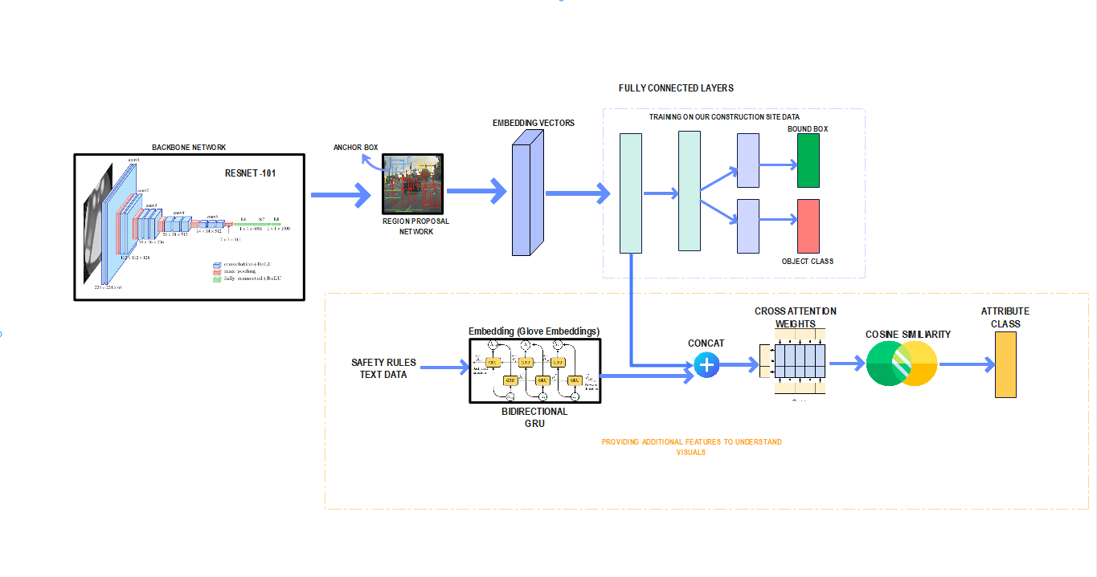
SYSTEM DESIGN – Phase I

Slide 21
WORKING
This work introduces a computer vision and deep learning method to match images of unsafe behavior with safety rules. This method includes:
1. Image feature representation.
2. Safety rule feature representation.
3. Feature fusion similarity to match unsafe behavior with safety rules.

Slide 22
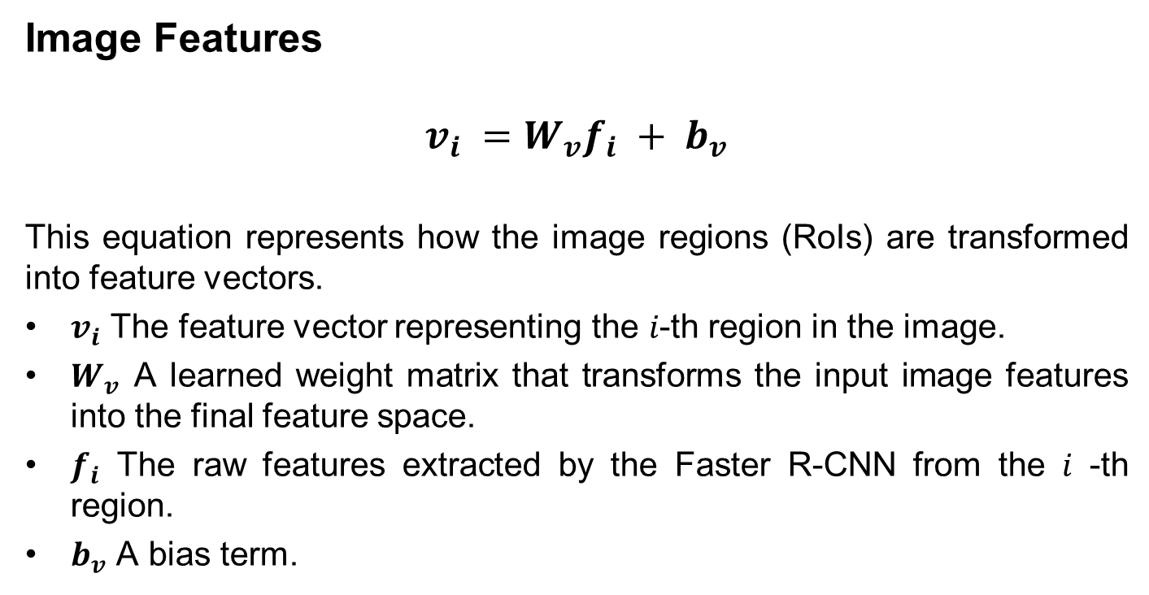
WORKING( CONTD…)
Image Features
$$v_{i} =W_{v}f_{i} + b_{v}$$
This equation represents how the image regions (RoIs) are transformed into feature vectors.
$v_{i}$ The feature vector representing the 𝑖-th region in the image.
$W_{v}$ A learned weight matrix that transforms the input image features into the final feature space.
$f_{i}$ The raw features extracted by the Faster R-CNN from the 𝑖 -th region.
$b_{v}$ A bias term.

Slide 23
BACKBONE NETWORK (ResNet-101)
Extracts visual features from input images for further analysis.
A deep convolutional neural network with 101 layers.
Key Features:
Provides feature maps representing important visual details.
Supports multi-scale feature extraction for detecting varied object sizes.

Slide 24
REGIONAL PROPOSAL NETWORK (RPN)
Identifies Regions of Interest (RoI) within the feature maps.
Mechanism:
Anchor Boxes: Generates potential object bounding boxes.
Classification: Scores each box as foreground or background.

Slide 25
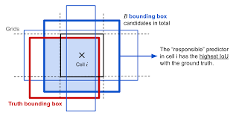
ANCHOR BOX WORKING
The Anchor generator generates anchor boxes of various sizes and aspect ratios:
Sizes: (32, 64, 128, 256, 512) (represents different scales).
Aspect Ratios: (0.5, 1.0, 2.0) (width-to-height ratios).

Slide 26
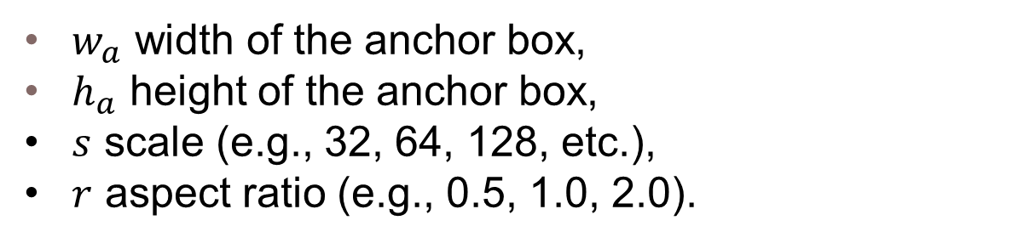

ANCHOR BOX WORKING
$$w_{a}=s .\sqrt{r}, { h}_{a}=s/{\sqrt{r}}$$
$w_{a}$ width of the anchor box,
$h_{a}$ height of the anchor box,
$s$ scale (e.g., 32, 64, 128, etc.),
$r$ aspect ratio (e.g., 0.5, 1.0, 2.0).

Slide 27
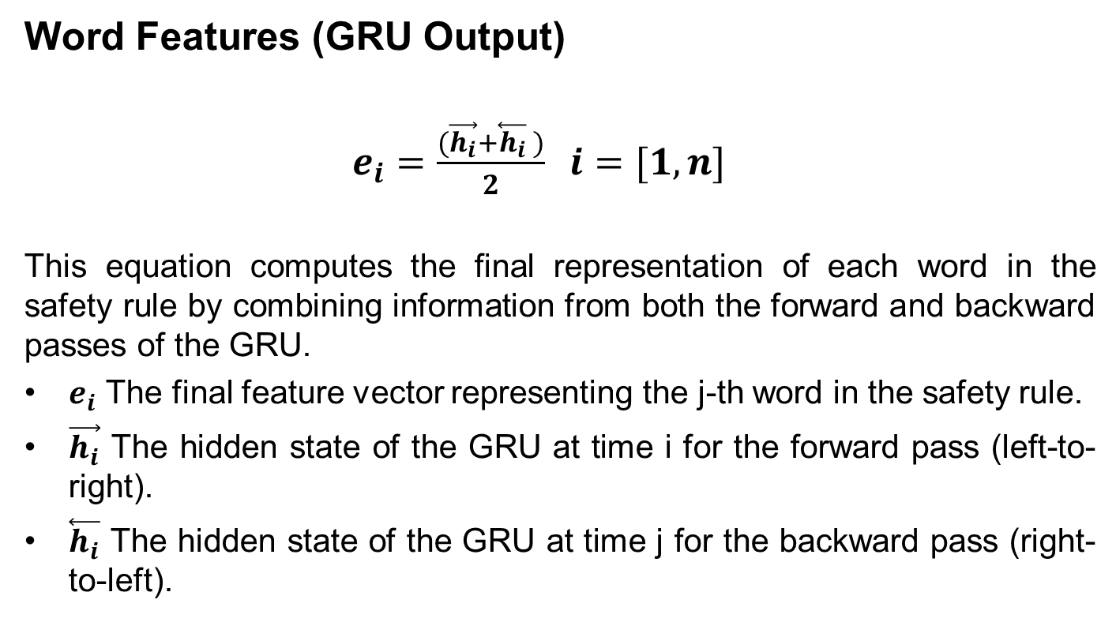
WORKING( CONTD…)
Word Features (GRU Output)
$e_{i}=\frac{(\vec{h_{i}}+\overset{⃖}{h_{i}} )}{2} i=[1,n]$
This equation computes the final representation of each word in the safety rule by combining information from both the forward and backward passes of the GRU.
$e_{i}$ The final feature vector representing the j-th word in the safety rule.
$\vec{h_{i}}$ The hidden state of the GRU at time i for the forward pass (left-to-right).
$\overset{⃖}{h_{i}}$ The hidden state of the GRU at time j for the backward pass (right-to-left).

Slide 28
ROLE IN ARCHITECTURE
The output of the Bidirectional GRU is combined with image features extracted by the backbone network.
This fusion occurs in the stacked cross-attention mechanism, where regions of the image are matched with relevant parts of the safety rule.

Slide 29
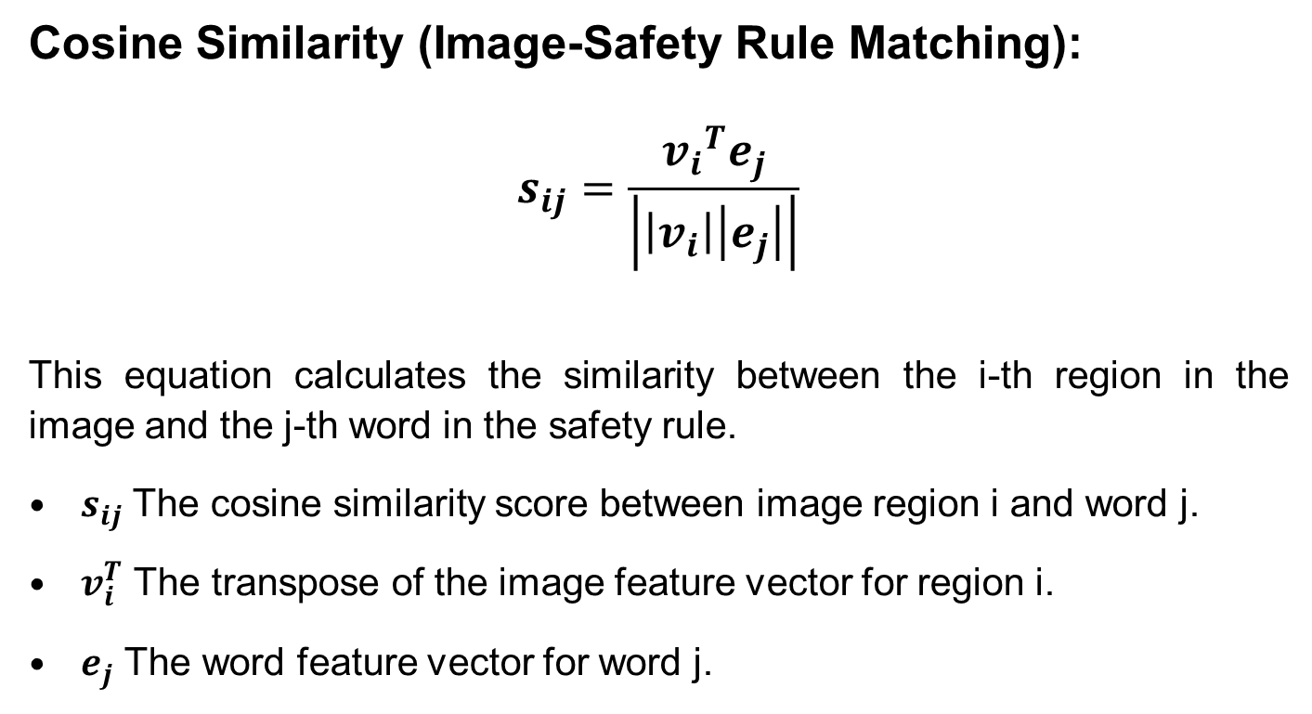
WORKING( CONTD…)
Cosine Similarity (Image-Safety Rule Matching):
$$s_{ij}=\frac{{v_{i}}^{T}e_{j}}{\left|\left|v_{i}\right|\left|e_{j}\right|\right|}$$
This equation calculates the similarity between the i-th region in the image and the j-th word in the safety rule.
$s_{ij}$ The cosine similarity score between image region i and word j.
$v_{i}^{T}$ The transpose of the image feature vector for region i.
$e_{j}$ The word feature vector for word j.

Slide 30
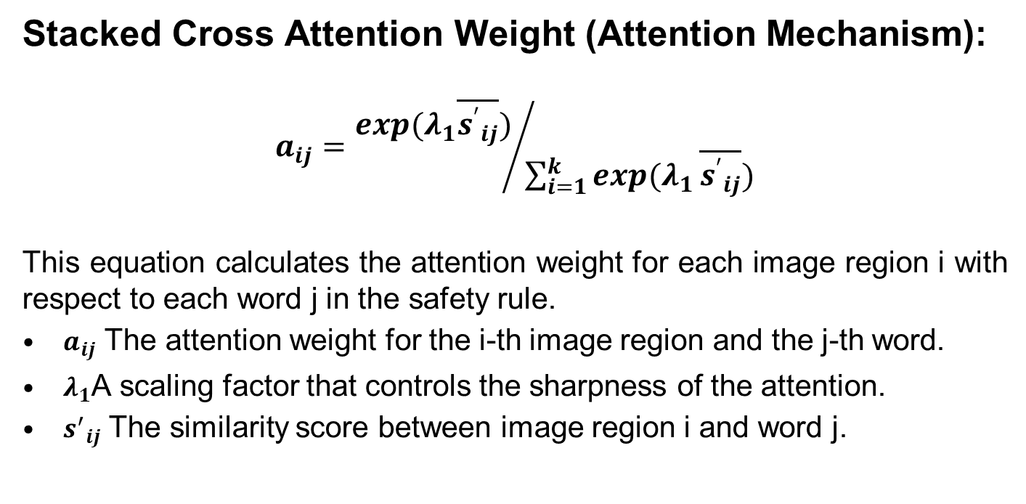
WORKING( CONTD…)
Stacked Cross Attention Weight (Attention Mechanism):
$$a_{ij}={exp(λ_{1}\overline{{s^{′}}_{ij}})}/{\sum_{i=1}^{k}{exp(λ_{1}}\overline{{s^{′}}_{ij}})}$$
This equation calculates the attention weight for each image region i with respect to each word j in the safety rule.
$a_{ij}$ The attention weight for the i-th image region and the j-th word.
$λ_{1}$A scaling factor that controls the sharpness of the attention.
${s^{′}}_{ij}$ The similarity score between image region i and word j.

Slide 31
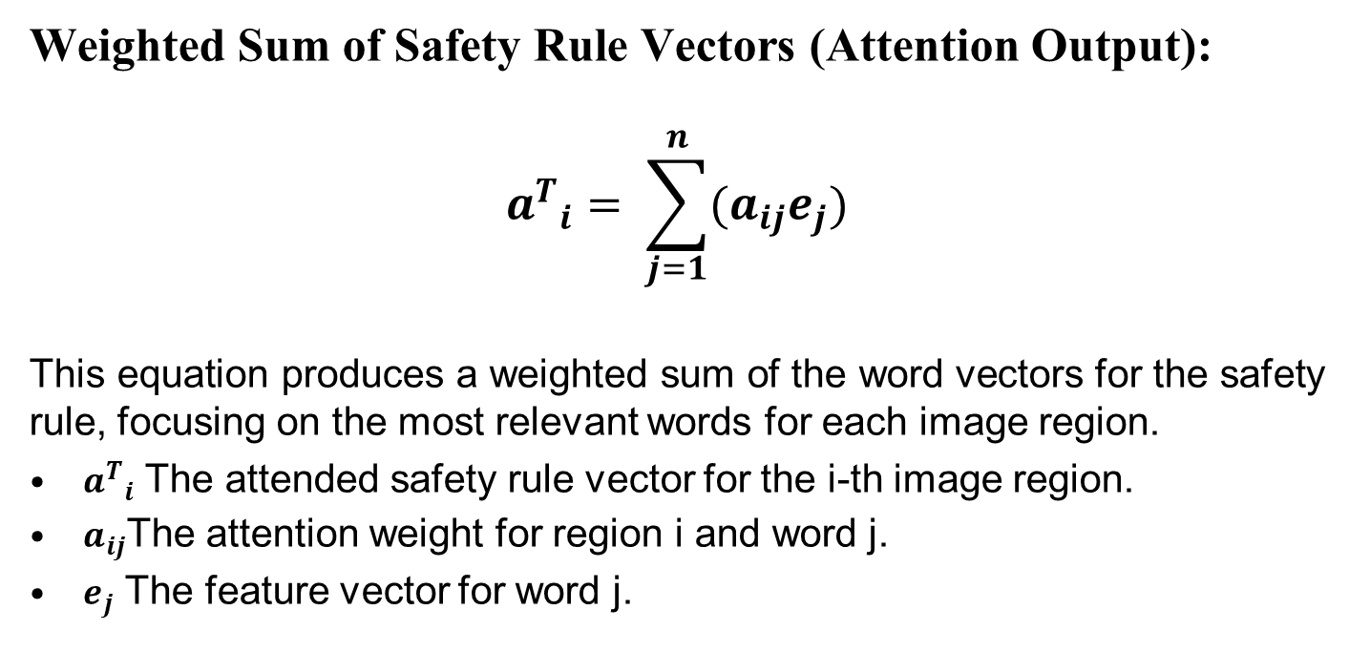
WORKING( CONTD…)
Weighted Sum of Safety Rule Vectors (Attention Output):
$${a^{T}}_{i}= \sum_{j=1}^{n}{(a_{ij}e_{j})}$$
This equation produces a weighted sum of the word vectors for the safety rule, focusing on the most relevant words for each image region.
${a^{T}}_{i}$ The attended safety rule vector for the i-th image region.
$a_{ij}$The attention weight for region i and word j.
$e_{j}$ The feature vector for word j.

Slide 32
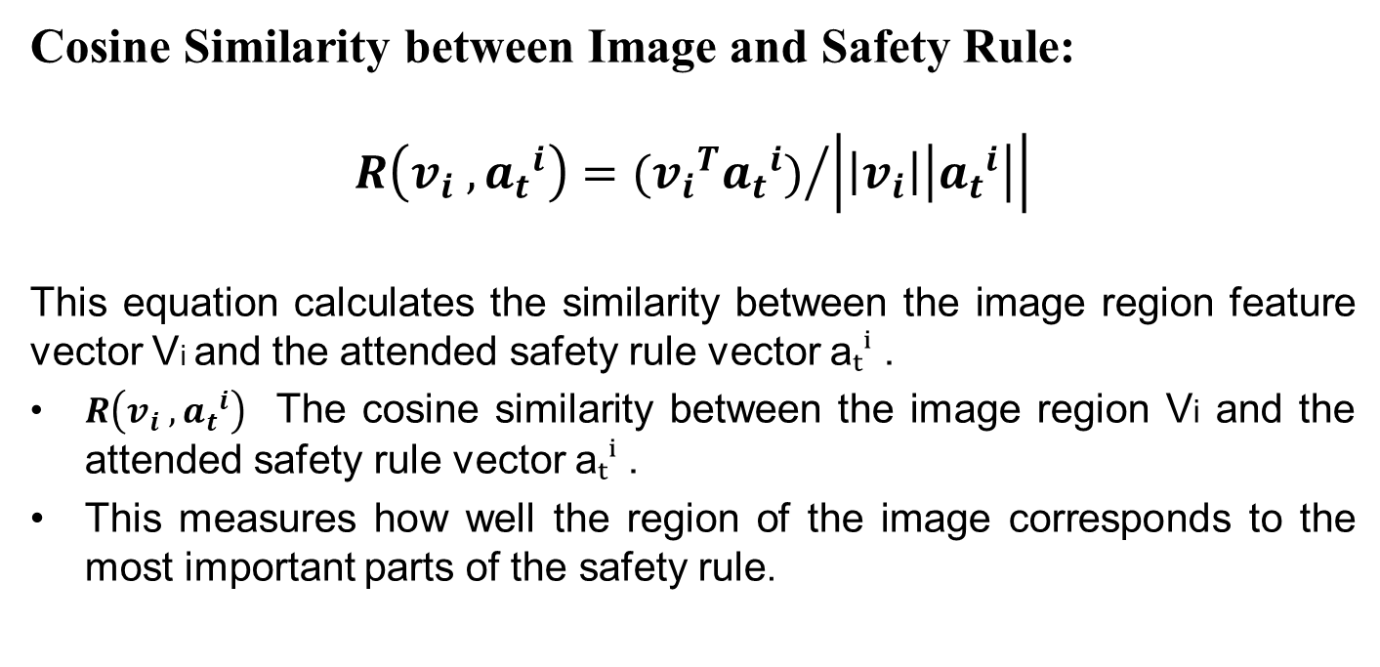
WORKING( CONTD…)
Cosine Similarity between Image and Safety Rule:
$$R\left(v_{i} , {a_{t}}^{i}\right)={({v_{i}}^{T}{a_{t}}^{i})}/{\left|\left|v_{i}\right|\left|{a_{t}}^{i}\right|\right|}$$
This equation calculates the similarity between the image region feature vector Vi​ and the attended safety rule vector aₜⁱ .
$R\left(v_{i} , {a_{t}}^{i}\right)$ The cosine similarity between the image region Vi and the attended safety rule vector aₜⁱ .
This measures how well the region of the image corresponds to the most important parts of the safety rule.

Slide 33
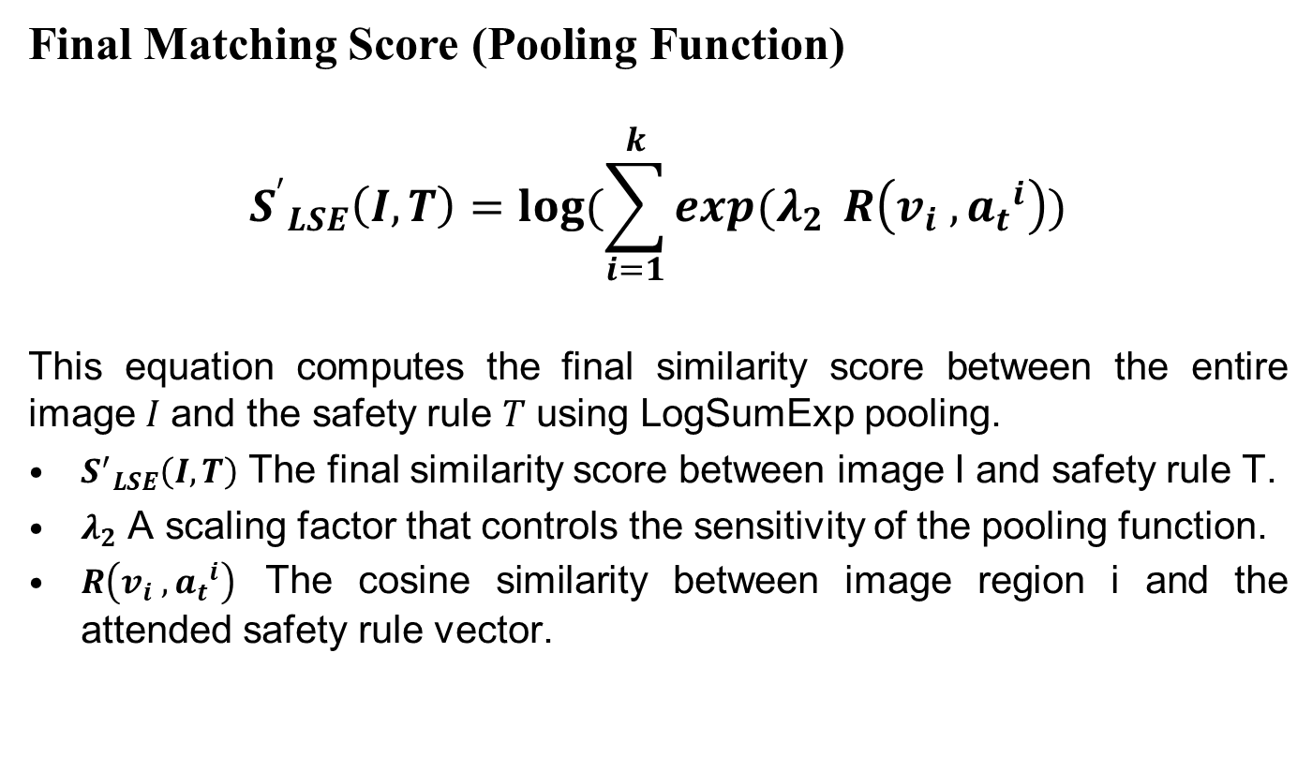
WORKING( CONTD…)
Final Matching Score (Pooling Function)
$${S^{′}}_{LSE}\left(I,T\right)=\log{(\sum_{i=1}^{k}{exp(λ_{2}}} R\left(v_{i} , {a_{t}}^{i}\right))$$
This equation computes the final similarity score between the entire image 𝐼 and the safety rule 𝑇 using LogSumExp pooling.
${S^{′}}_{LSE}\left(I,T\right)$ The final similarity score between image I and safety rule T.
$λ_{2}$ A scaling factor that controls the sensitivity of the pooling function.
$R\left(v_{i} , {a_{t}}^{i}\right)$ The cosine similarity between image region i and the attended safety rule vector.

Slide 34
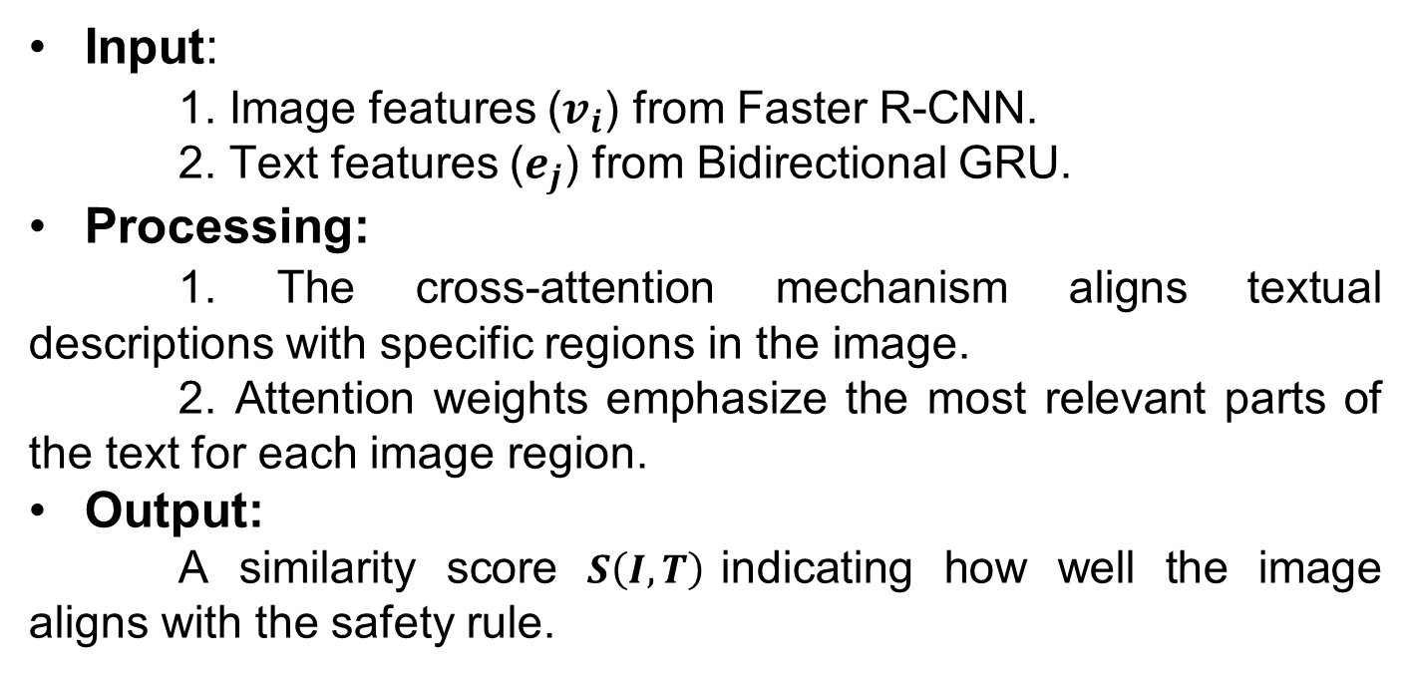
ROLE IN ARCHITECTURE
Input:
1. Image features ($v_{i}$) from Faster R-CNN.
2. Text features ($e_{j}$) from Bidirectional GRU.
Processing:
1. The cross-attention mechanism aligns textual descriptions with specific regions in the image.
2. Attention weights emphasize the most relevant parts of the text for each image region.
Output:
A similarity score $S\left(I,T\right)$indicating how well the image aligns with the safety rule.

Slide 35
Matching Unsafe Behaviors:
The similarity score 𝑺(𝑰,𝑻) determines how well the image features (detected unsafe behavior) match the textual safety rule.
Training Objective:
The similarity score is optimized using loss functions (e.g., triplet loss) to improve the alignment between images and rules.

Slide 36
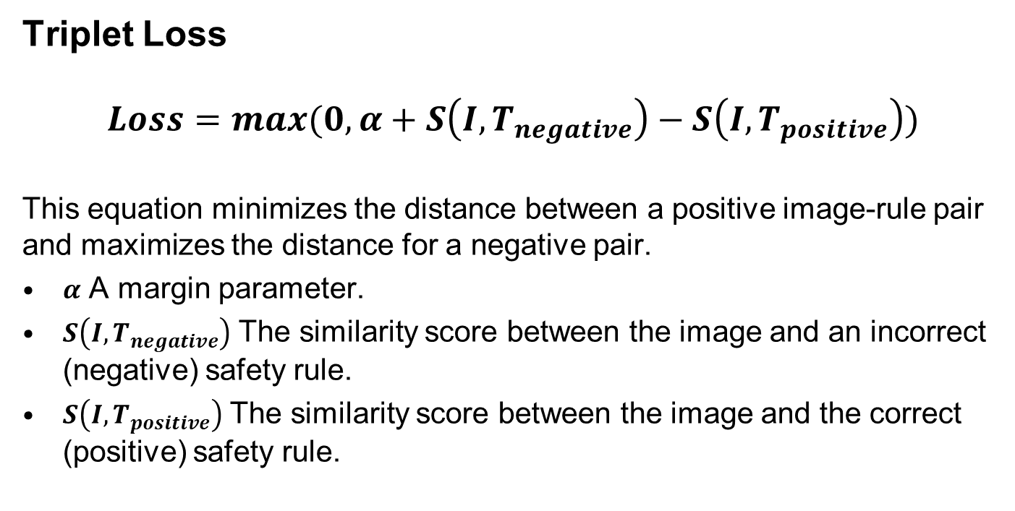
WORKING( CONTD…)
Triplet Loss
$$Loss=max(0,α+S\left(I,T_{negative}\right)−S\left(I,T_{positive}\right))$$
This equation minimizes the distance between a positive image-rule pair and maximizes the distance for a negative pair.
$α$ A margin parameter.
$S\left(I,T_{negative}\right)$ The similarity score between the image and an incorrect (negative) safety rule.
$S\left(I,T_{positive}\right)$ The similarity score between the image and the correct (positive) safety rule.

Slide 37
YOLO - Efficient Small-target and Context Attention (ESCA)
It is an improved version of the YOLOv5 model, designed to detect safety helmet-wearing behavior.
The enhancements include:
EIOU-loss for better bounding box prediction.
Soft-NMS for improved handling of overlapping objects.
CBAM (Convolutional Block Attention Module) for better focus on important regions, especially small targets like helmet straps.
ADL (small-target detection layer) for better performance on small, distant, or occluded object

Slide 38
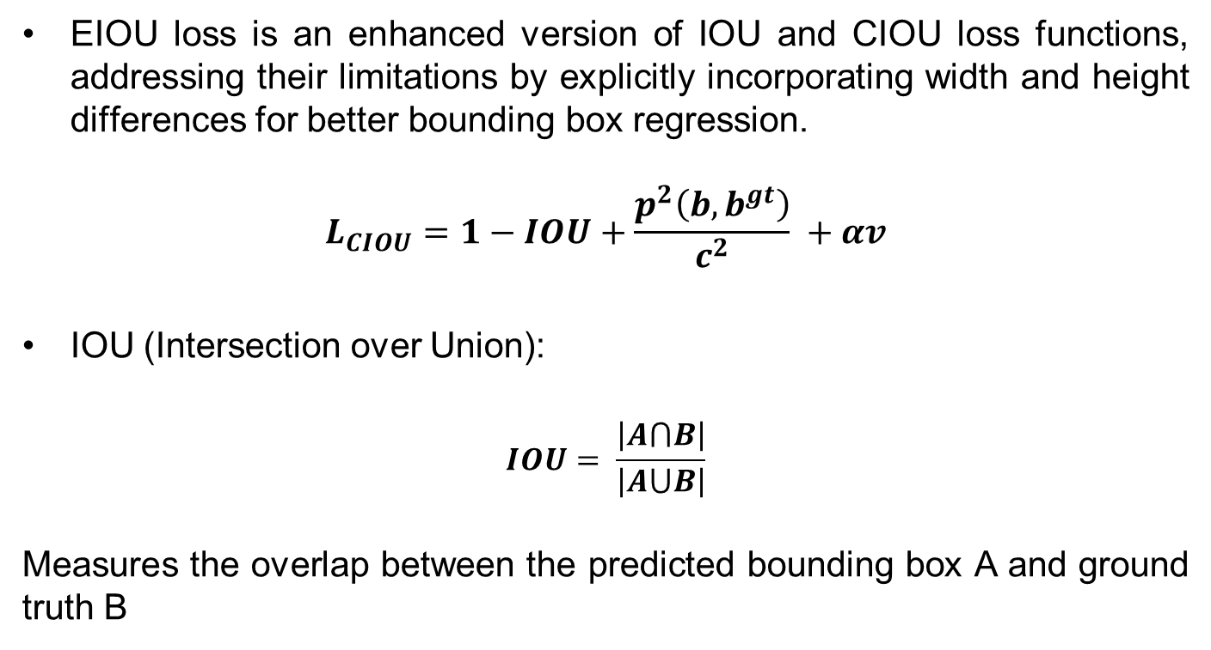
EIOU LOSS
EIOU loss is an enhanced version of IOU and CIOU loss functions, addressing their limitations by explicitly incorporating width and height differences for better bounding box regression.
$$L_{CIOU}=1−IOU+\frac{p^{2}\left(b,b^{gt}\right)}{c^{2}} +αv$$
IOU (Intersection over Union):
$$IOU= \frac{\left|A⋂B\right|}{\left|A⋃B\right|}$$
Measures the overlap between the predicted bounding box A and ground truth B

Slide 39
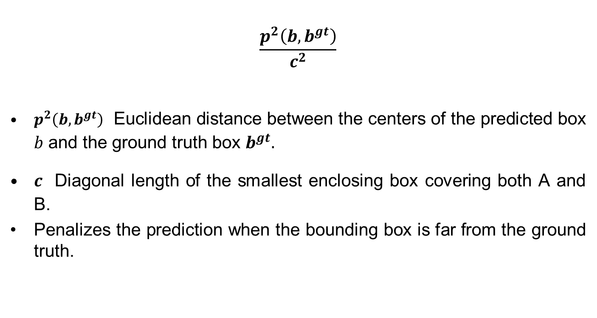
Contd…
$$\frac{p^{2}\left(b,b^{gt}\right)}{c^{2}}$$
$p^{2}\left(b,b^{gt}\right)$ Euclidean distance between the centers of the predicted box 𝑏 and the ground truth box $b^{gt}.$
$c$ Diagonal length of the smallest enclosing box covering both A and B.
Penalizes the prediction when the bounding box is far from the ground truth.

Slide 40
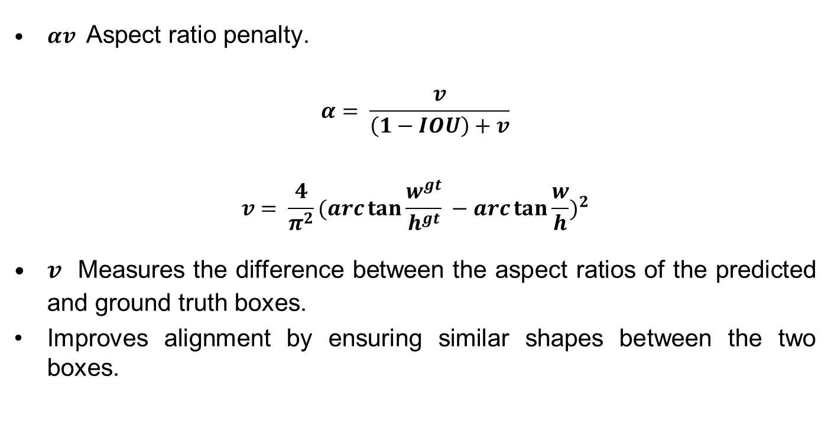
Contd…
$αv$ Aspect ratio penalty.
$$α= \frac{v}{\left(1−IOU\right)+v}$$
$$v= \frac{4}{π^{2}}(arc\tan{\frac{w^{gt}}{h^{gt}} −arc\tan{\frac{w}{h})^{2}}}$$
$v$ Measures the difference between the aspect ratios of the predicted and ground truth boxes.
Improves alignment by ensuring similar shapes between the two boxes.

Slide 41
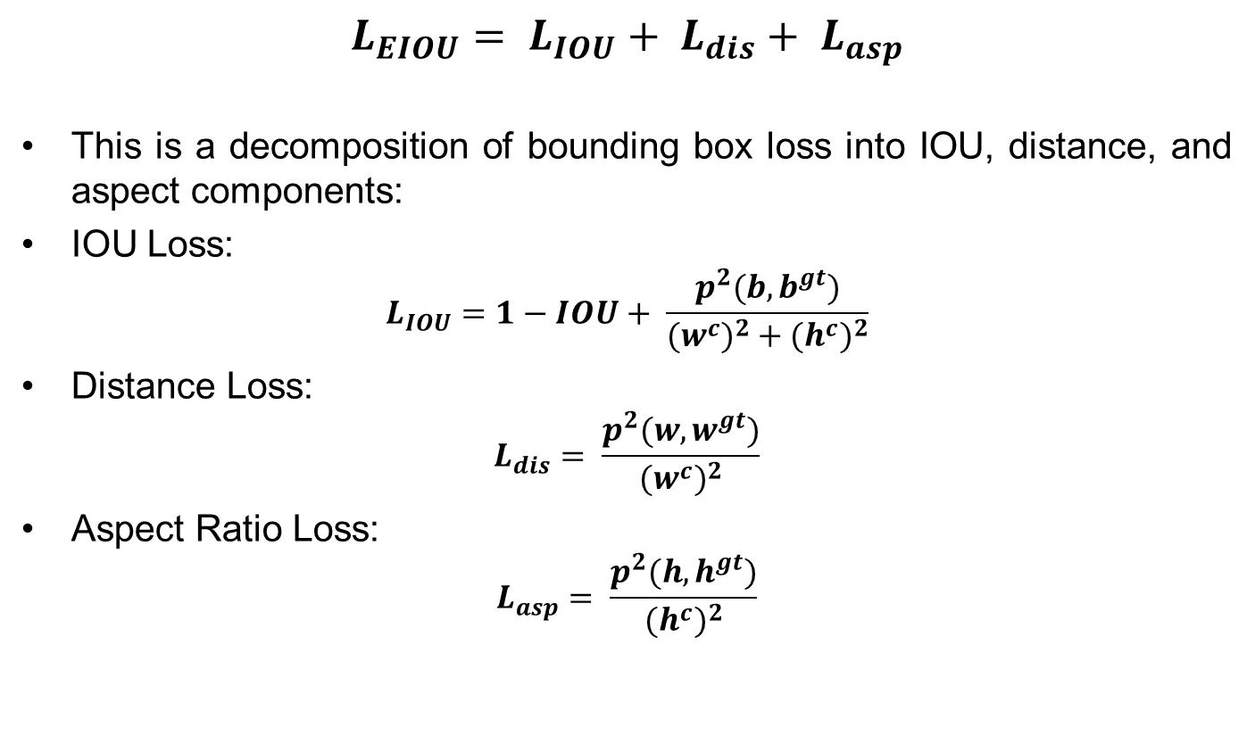
EIOU LOSS
$$L_{EIOU}= L_{IOU}+ L_{dis}+ L_{asp}$$
This is a decomposition of bounding box loss into IOU, distance, and aspect components:
IOU Loss:
$$L_{IOU}=1−IOU+ \frac{p^{2}(b,b^{gt})}{(w^{c})^{2}+(h^{c})^{2}}$$
Distance Loss:
$$L_{dis}= \frac{p^{2}(w,w^{gt})}{(w^{c})^{2}}$$
Aspect Ratio Loss:
$$L_{asp}= \frac{p^{2}(h,h^{gt})}{(h^{c})^{2}}$$

Slide 42
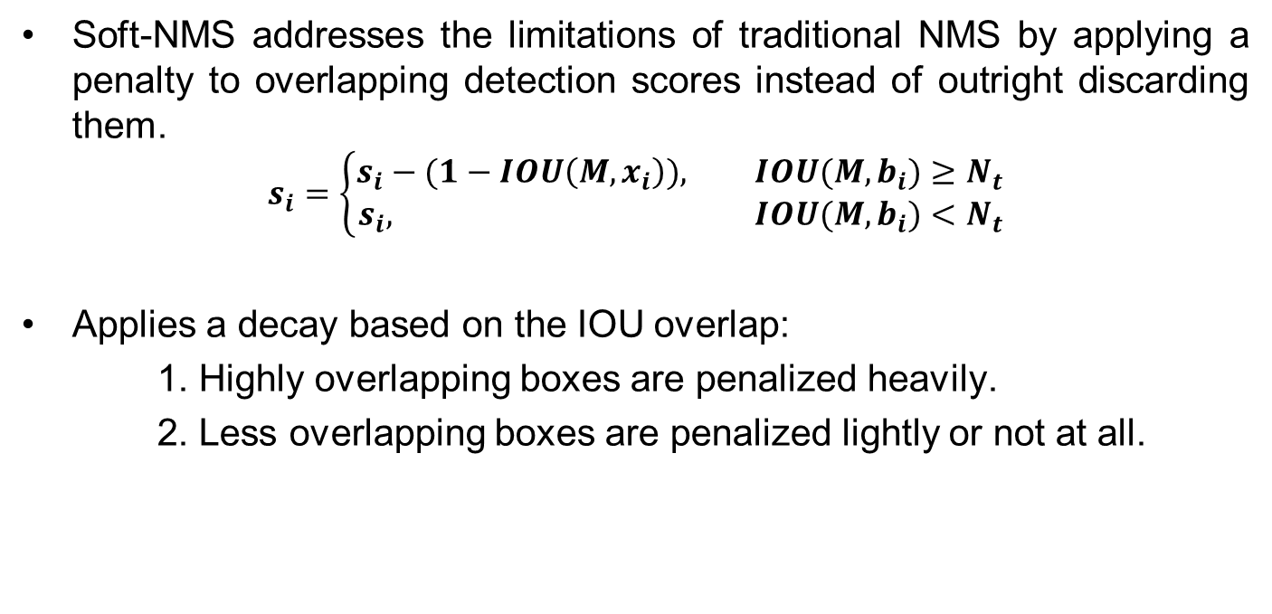
Soft-Non-Maximum Suppression
Soft-NMS addresses the limitations of traditional NMS by applying a penalty to overlapping detection scores instead of outright discarding them.
$$s_{i}=\left\{\begin{aligned}s_{i}−(1−IOU\left(M,x_{i}\right)), &IOU(M,b_{i})≥N_{t} \\ s_{i}, &IOU(M,b_{i})<N_{t}\end{aligned}\right.$$
Applies a decay based on the IOU overlap:
1. Highly overlapping boxes are penalized heavily.
2. Less overlapping boxes are penalized lightly or not at all.

Slide 43
Convolutional Block Attention Module
The Convolutional Block Attention Module (CBAM) is a lightweight attention mechanism designed to capture both the channel and spatial dimensions.
CBAM consists of two sub-modules:
1.Channel Attention Module (CAM)
2.Spatial Attention Module (SAM)

Slide 44
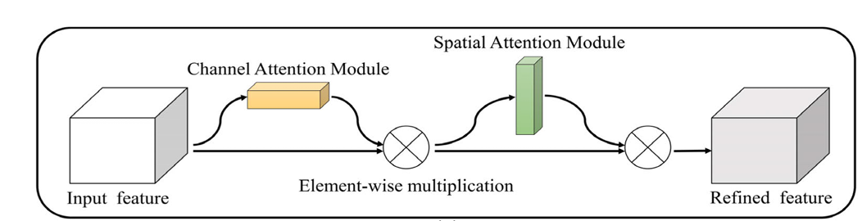
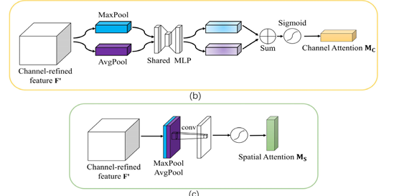
CBAM (Contd…)

Slide 45
Adaptive Detection Layer
ADL plays a critical role in enhancing the detection capabilities of the model for small targets, such as helmet chin straps.
ADL is added as an extra detection layer, which allows the model to better capture fine details at lower resolutions (e.g., 160x160 feature maps).

Slide 46
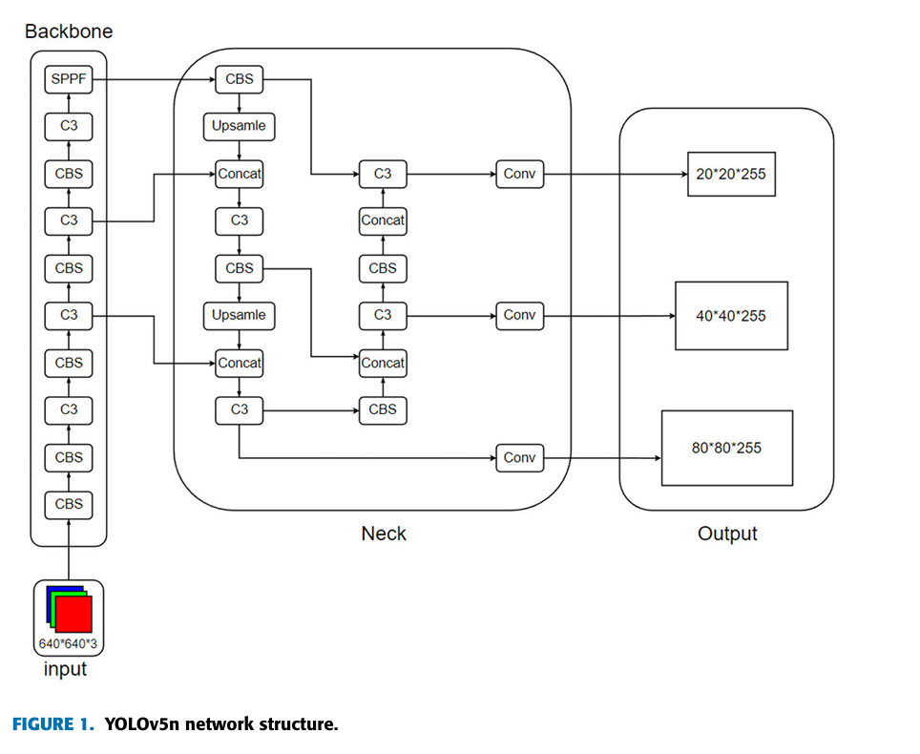
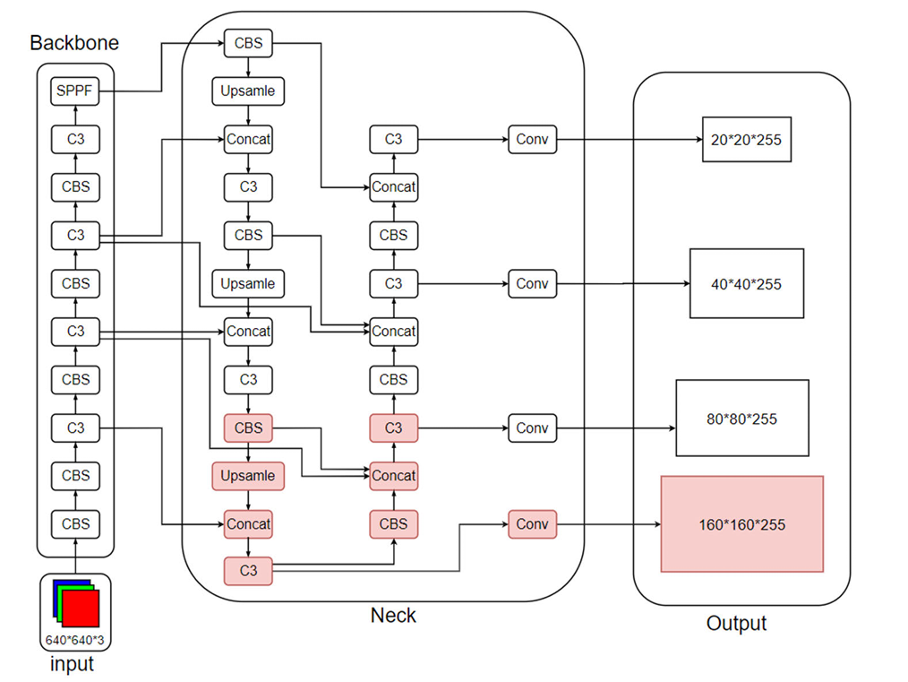
YOLO V5 vs YOLO ESCA
YOLO-V5
YOLO-ESCA

Slide 47
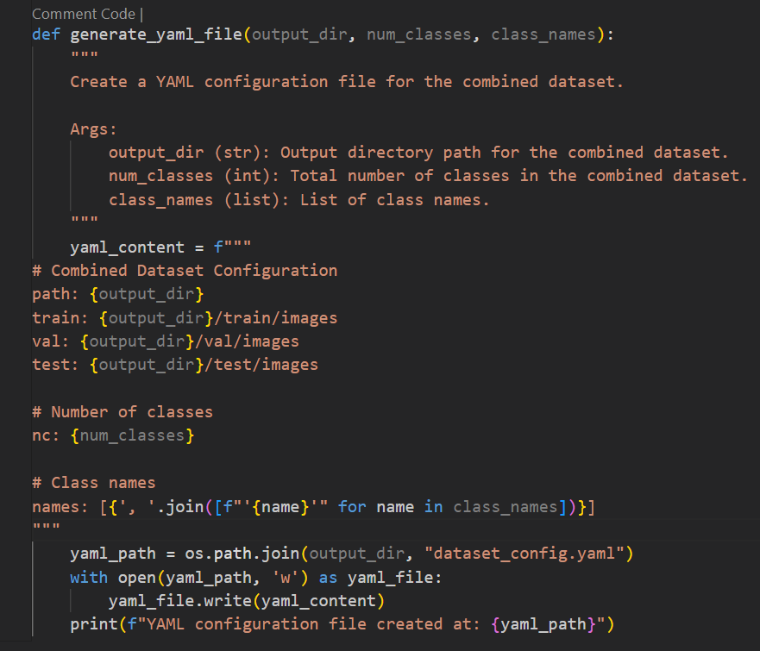
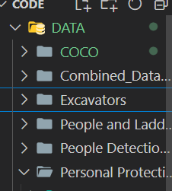
Results
Data Combination
Dataset
YAML file Creation for Meta data

Slide 48
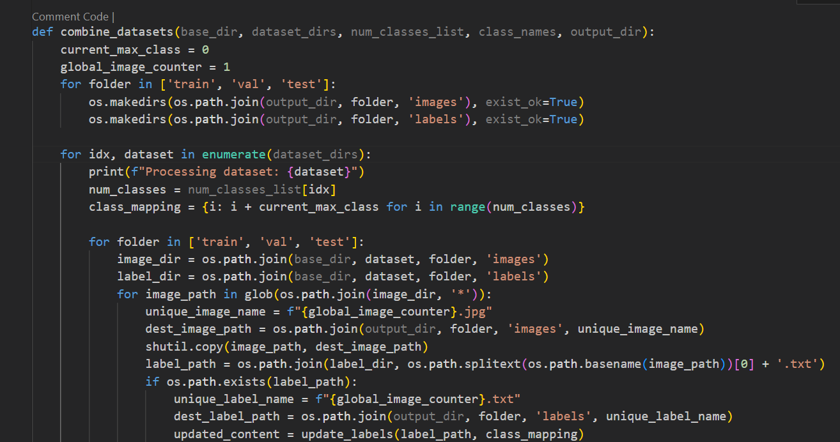
Results
Data Combination (Contd…)
Combining dataset

Slide 49
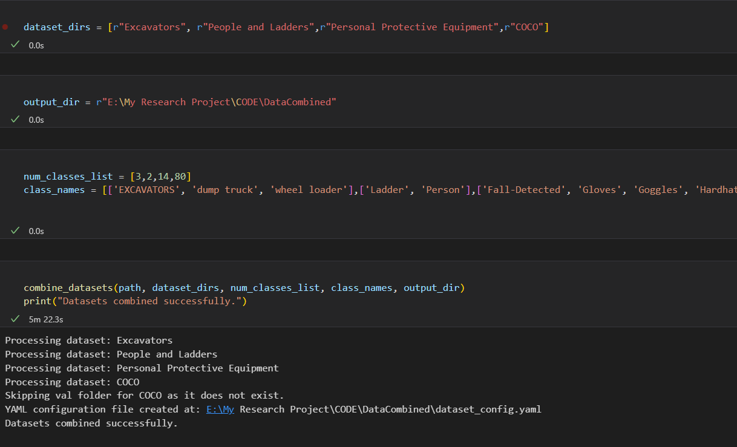
Results
Output of Data Combination

Slide 50
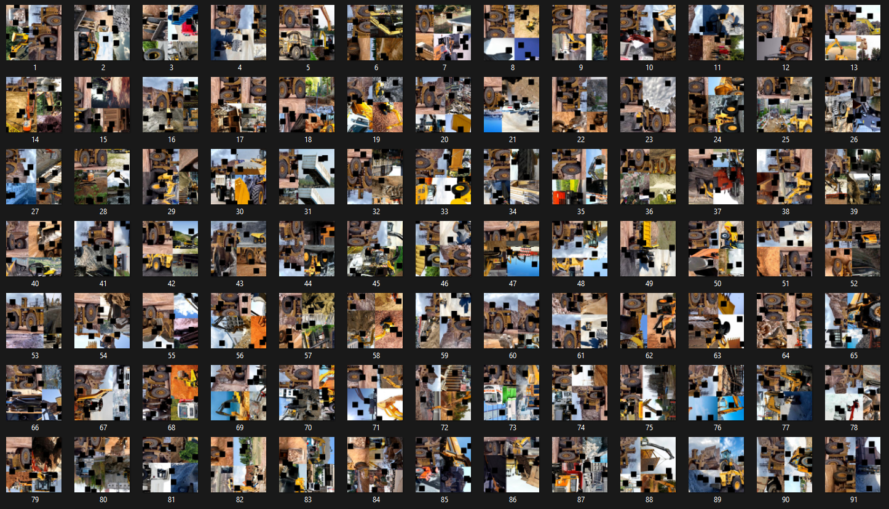
Results
Output of Data Combination

Slide 51
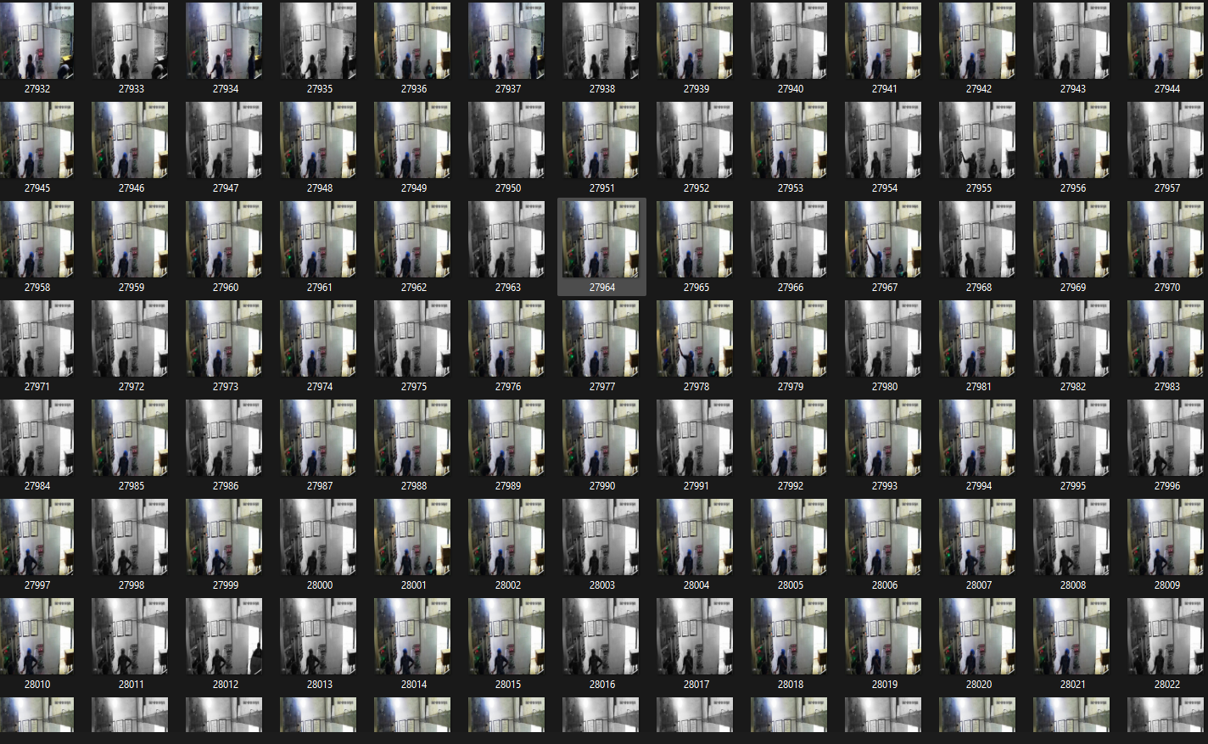
Results
Output of Data Combination

Slide 52
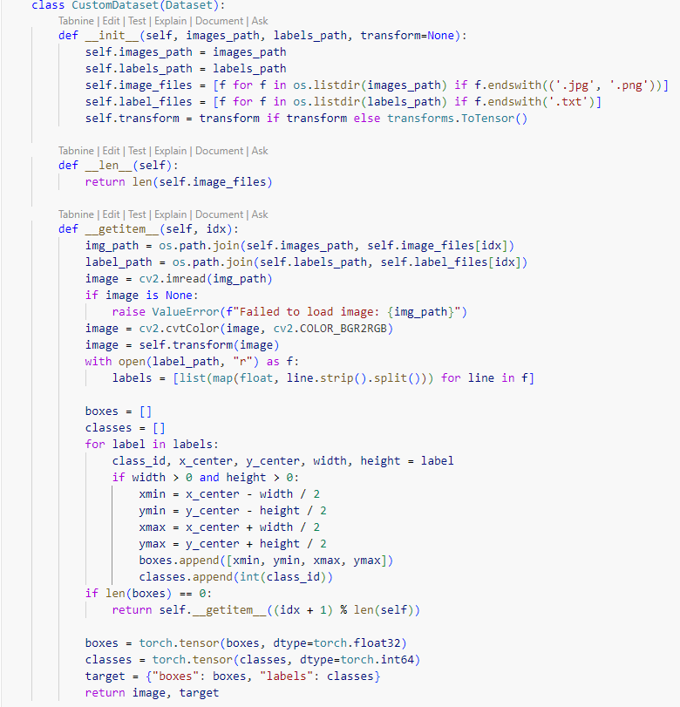
Results
Custom dataset loading Class

Slide 53
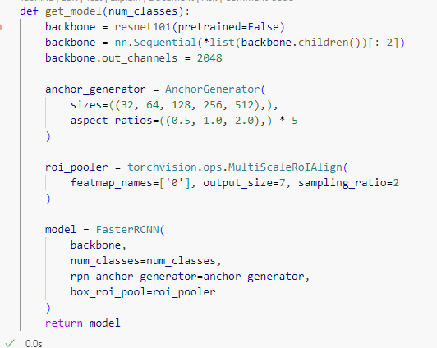
Results
Back bone network implementation

Slide 54
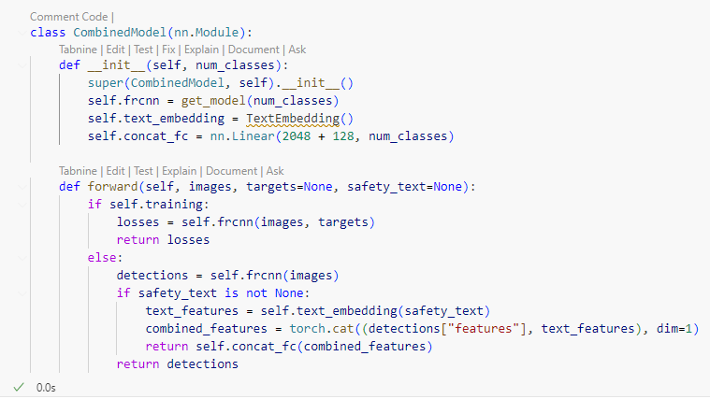
Results
Combined Model (Text and Image Features):

Slide 55
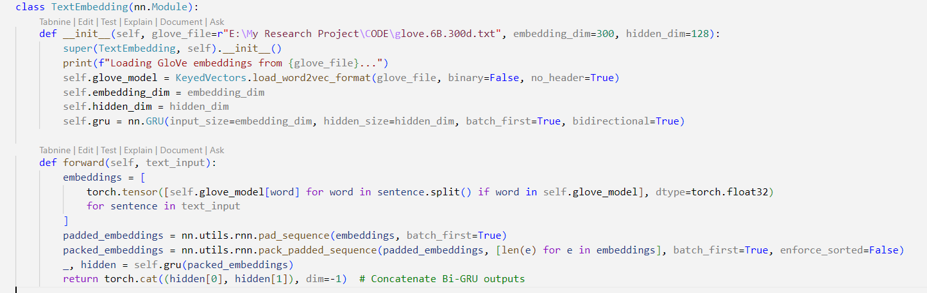
Results
Text Embedding

Slide 56
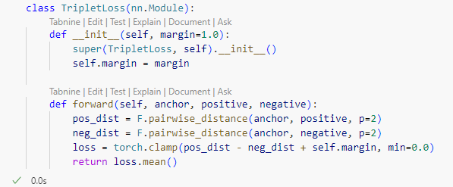
Results
Triplet Loss

Slide 57
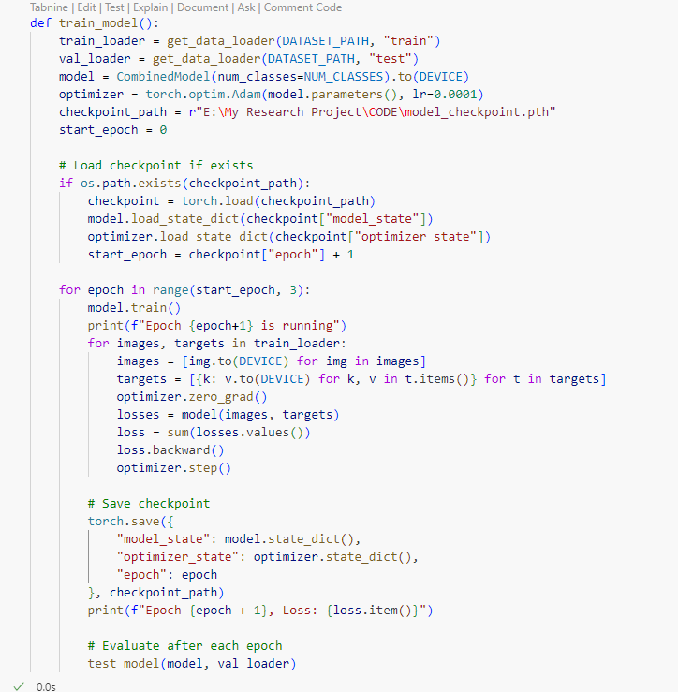
Results
Model Training

Slide 58
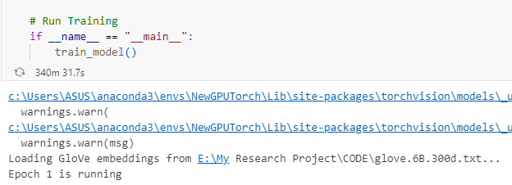
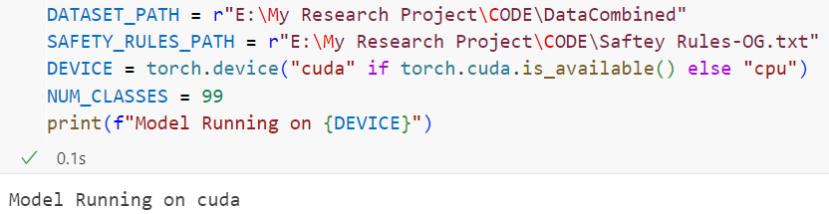
Results
Model Training

Slide 59
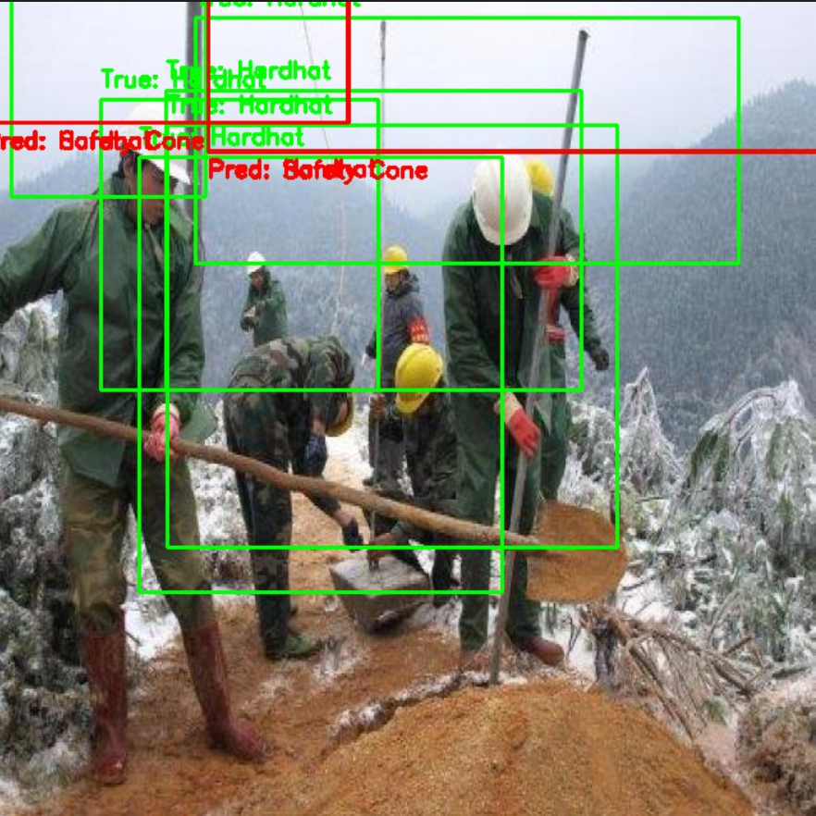
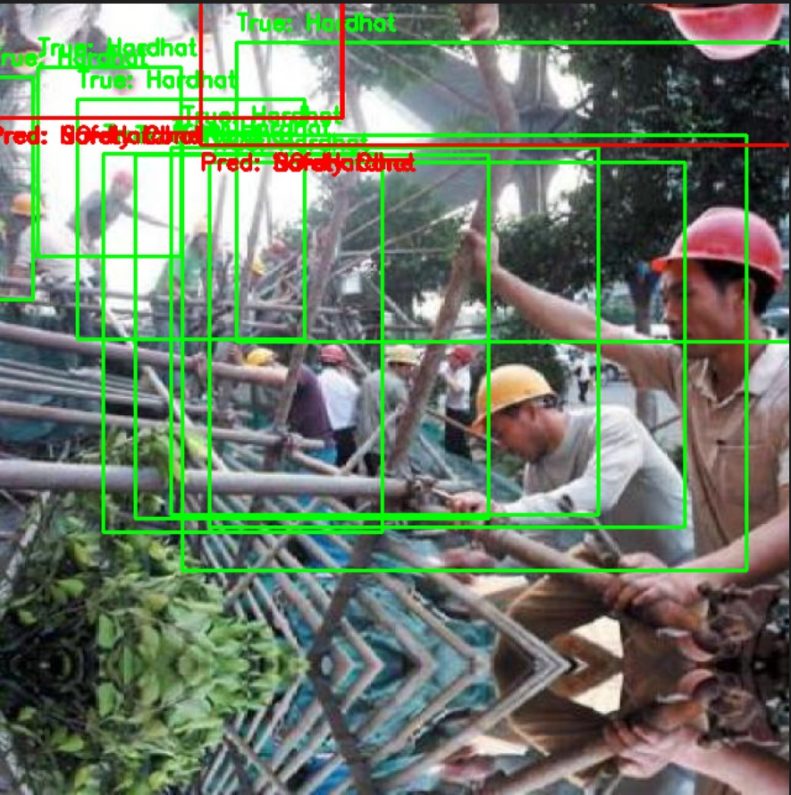
Results
Model Prediction

Slide 60
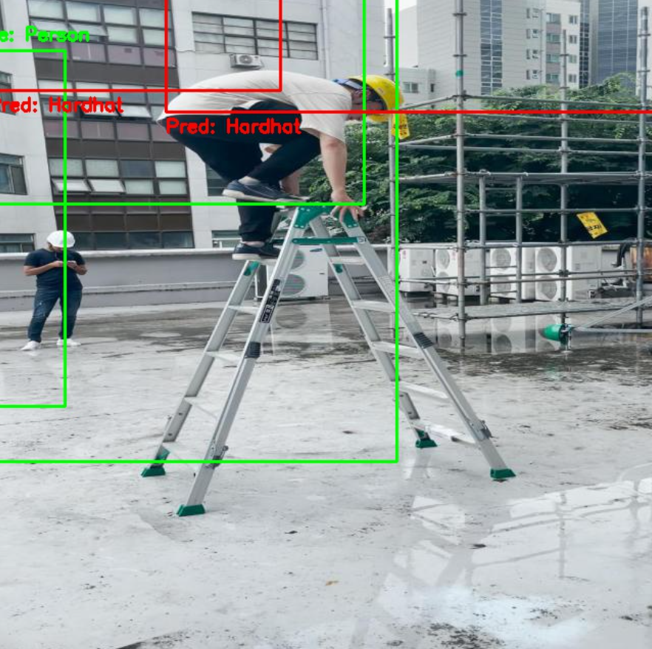
Results
Model Prediction

Slide 61
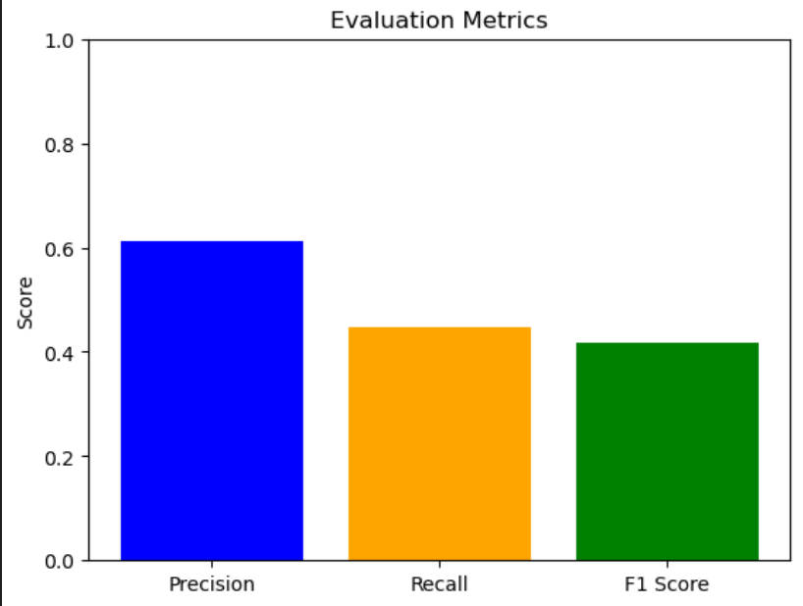
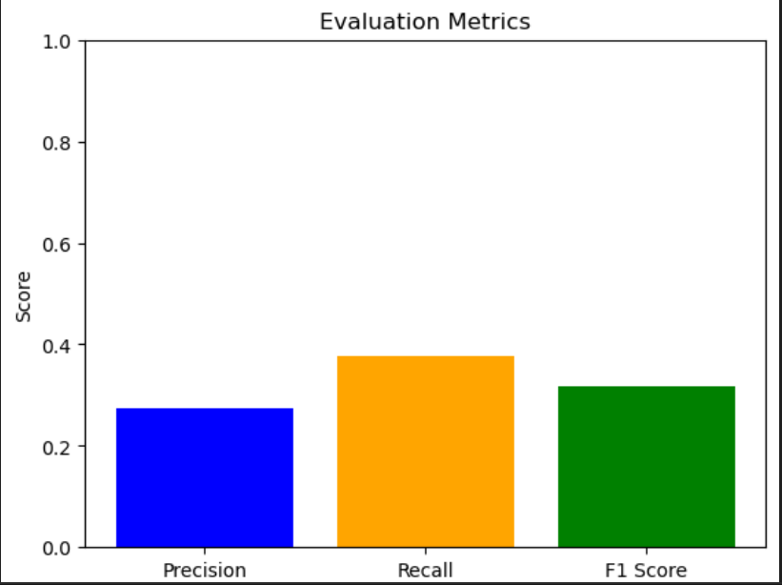
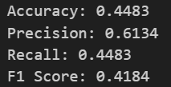
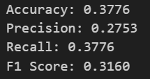
Results
Model Evaluation
With SCAN
Without SCAN

